Slide 1

Anomaly Detection in vessel traffic

Slide 2
Content
Our goal
Neural Network
Statistical approach
Conclusion

Slide 3
Our goal
Detecting anomalies in maritime vessel traffic
What is an Anomaly
How do we detect them
Neural network
Statistical Approach

Slide 4
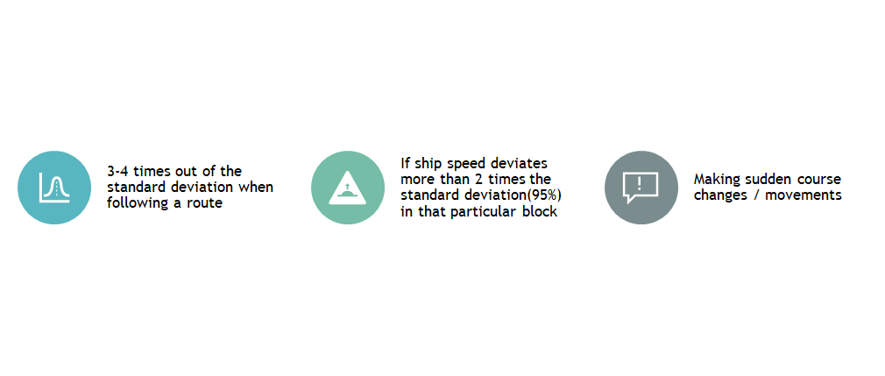
What is an anomaly

Slide 5
What is an anomaly
A deviation from normality
Can we make them?

Slide 6
How to detect Anomalies
Neural Network
Initially Recurrent Neural network
Normal Dense layer Neural Network worked better
From prediction to Classification
Statistical Approach
Density maps
Markov Models
Clustering

Slide 7
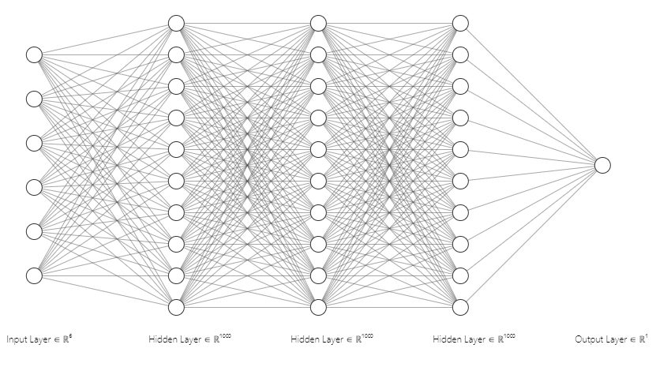
Neural Network
3 Hidden layers
1000 nodes per layer
Simulated anomalies
6 input features

Slide 8
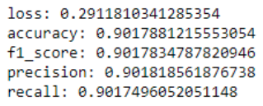

Neural Network results
Raw results
Confusion matrix

Slide 9
Prototype

Slide 10
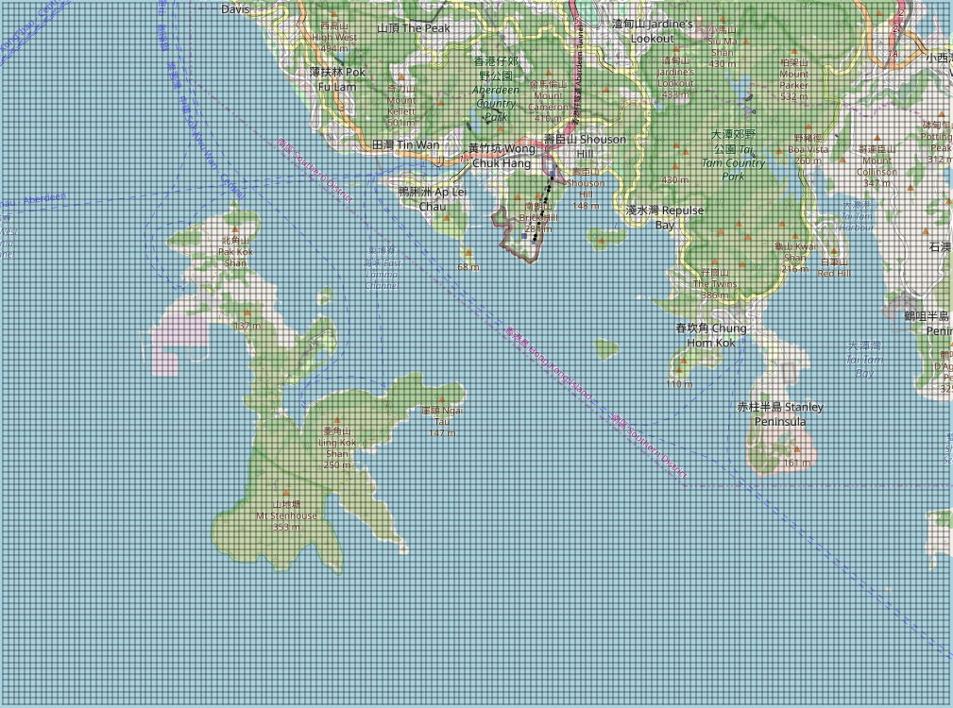
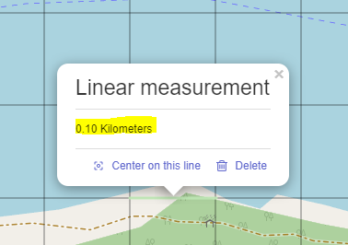
Statistical Approach
An Unsupervised version of KNN
Nodes
The grid

Slide 11
Statistical approach
Main Assumption:
An Anomaly is something that does not happen frequently.
Algorithm:
For each node compute the normal behaviour of an evaluated feature
=
What normally happens according to history?

Slide 12
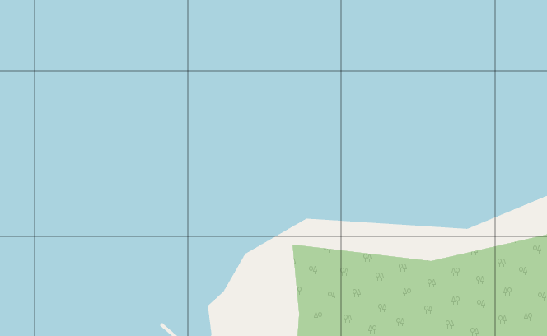
Statistical approach
Let’s go with an example…
Lets evaluate the normalcy in the direction of the ships:
Given a ship at point A
2. We look for the historical information about what are the normal directions in the closest node
Closest node
A
A

Slide 13
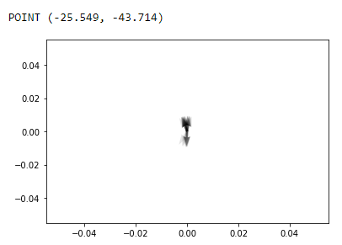
Statistical approach
For each node we have previously saved the historical information and we can compute statistics.
The normal directions that historically ships follow at the node we are looking into are:
As we can see, there are some clear main directions
→
Everything far from those is an anomaly
NOTE: In this graph, all the directions of the node are plotted with transparency of 0.2
The darker → The more frequent

Slide 14
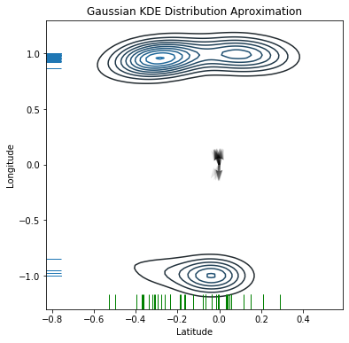
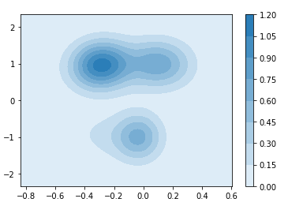
Statistical approach
Approximating the distribution with al algorithm named KDE (Kernel Density Estimation), we can get to rate the density of a given direction within a node.
KDE Density plot
NOTE:
More concentric circles
→
More normal area to face

Slide 15
Statistical approach
Using KDE to approximate the density distribution of the feature evaluated at each node.
So far implemented for speed and direction
Currently evaluating speed model
Implemented a buffer with 5 steps to clear the noise (little anomalies that do not make sense at all:
Detecting:
As BLUE: Anchored ships → They should be treated differently → working on that
As ORANGE: Trajectories for which we do not have enough info in its closest node to conclude anything → Can be fixed with more data
As RED: Anomaly according to the historical data in the closest node.
As GREEN: Normal behaviors.
About noise (LITTLE ANOMALIES): To get printed as RED, ORANGE or BLUE we take into account 5 steps.
If within those 5 steps more than the 60% of the transitions have been labeled under the same color, the transition we are evaluating will get that color.

Slide 16
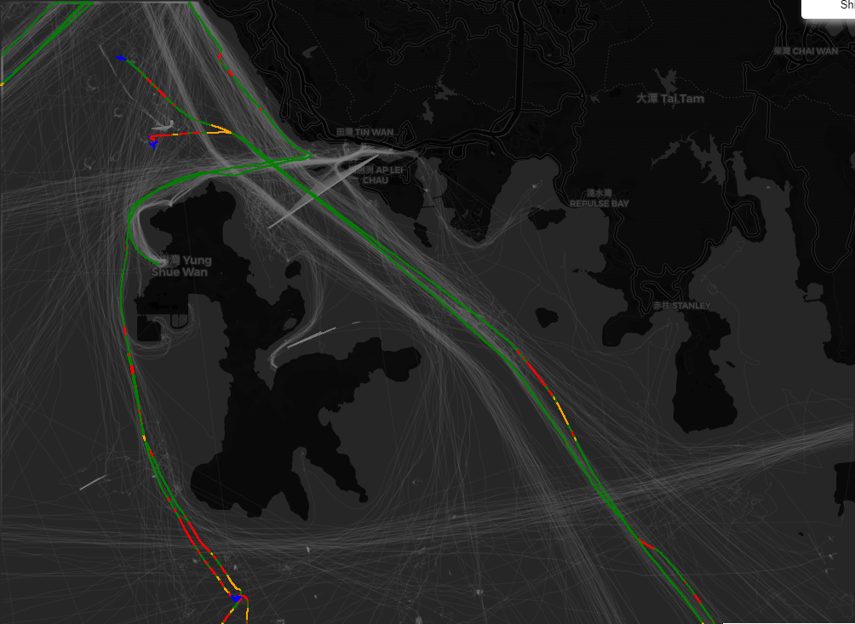
Results. Direction
Where do those reds come from?
Sudden change on the course
Weird direction
Crossing ships going in the opposite direction area
Crossing a junction

Slide 17
Conclusion
Final work
Comparing results
Same dataset
Research paper

